Slide 1
RESEARCH FOR PUBLIC POLICY WITH
A FOCUS ON CONSUMER INTEREST RESEARCH (PPOCIR)
RECHERCHE SUR LES INTÉRÊTS DES CONSOMMATEURS AXÉE SUR LES POLITIQUES PUBLIQUES (RICAPP)
Supported by a Three-Year Partnership Development Grant of the Social Sciences and Humanities Research Council of Canada
Consumer Groups Meetings: Ottawa
Feb 21, 2018
With OCA; FCAC; CB/BC; CRTC; Consumer NGOs
Robert R. Kerton
Economics, University of Waterloo, Canada
Principal Investigator, SSHRC Partnership for PPOCIR

Slide 2
The Plan of the Presentation
Highlighting Canada’s Approach to Consumer Protection
1. Consumer Protection Agencies in Canada: Some Essential Institutions are Absent;
Partnered CIR is a Partial Response
2. One Academic Model and a Partnership Model
a) Normal Academic Research Model
b) Inclusion: Four Different Types of Partners
3. Some Dimensions of Partnership Achievement
Seven Metrics to Calibrate Success
4. The Next Partnership … New Opportunity

Slide 3
CONSUMER INSTITUTIONS ABSENT IN CANADA
A National Centre for Consumer-Interest Research
(available in many advanced countries)
Product-testing Agencies like Que Choisir, Finanztest, Which? or Consumer Reports (Protégez-vous contributes services in French)
Academic Journals for Consumer Research (scholars publish elsewhere)
National Institute with Credible Quality Ratings Publicly Provided (16 countries use statistical methodology of the American Customer Satisfaction Index ACSI http://www.theacsi.org/ )
Q: Can a Public-Policy-Consumer-Research Partnership fill some of the void?

Slide 5
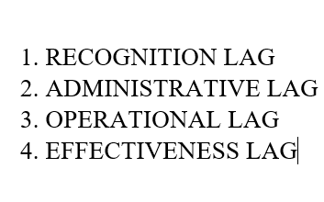


Slide 6
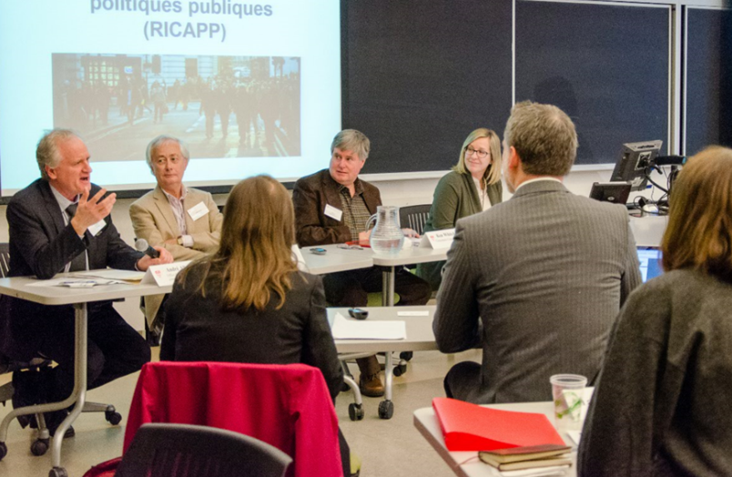
IDENTIFYING RESEARCH TOPICS AND IMPLEMENTATION WITH THE PPOCIR / RICAPP PARTNERSHIP MODEL
DEFINE RESEARCH
TOPICS
NGOS
POLICY EXPERTISE
PRIVATE:
CSA
PPOCIR RICAPP 2015 McGill Workshop
NGOs PROVIDE: RECOGNITION + MOBILIZATION
PRIVATE SECTOR: ADMINISTRATION + EFFECTIVENESS
POLICY EXPERTS RECOGNITION + IMPLEMENTABILITY
RESEARCH EXECUTION IS WITH SUPERVISED GRAD STUDENTS

Slide 7
CANADA - RESEARCH FOR PUBLIC POLICY WITH
A FOCUS ON CONSUMER INTEREST RESEARCH (CIR)
PARTNERS - IN THE FIRST SSHRC PARTNERSHIP GRANT 2013-2017
Research Activities 2013-2017: http://ppocir.uwaterloo.ca/ppocir-knowledge-centre/
GOVERNMENT ORGANIZATIONS
FINANCIAL CONSUMER AGENCY OF CANADA
CANADA, OCA - MINISTRY OF INNOVATION, SCIENCE AND ECONOMIC DEVELOPMENT
OFFICE DE LA PROTECTION DU CONSOMMATEUR DU QUÉBEC
ONTARIO’S MINISTRY OF GOVERNMENT AND CONSUMER SERVICES
NGO CONSUMER GROUPS
CONSUMERS COUNCIL OF CANADA
OPTION CONSOMMATEURS
PUBLIC INTEREST ADVOCACY CENTRE
UNION DES CONSOMMATEURS
UNIVERSITIES
UNIVERSITY OF WATERLOO
RYERSON UNIVERSITY
UNIVERSITY OF ALBERTA
GUELPH UNIVERSITY
LAVAL UNIVERSITY
MCGILL UNIVERSITY
PRIVATE SECTOR REPRESENTATIVES
CSA GROUP (STANDARDS)

Slide 8
MEASURING ACHIEVEMENTS OF A PARTNERSHIP 2014-2018:
PUBLIC POLICY ORIENTED CONSUMER INTEREST RESEARCH
SSHRC-SUPPORTED
1. RESEARCH WITH DEDICATED POLICY FOCUS
More than 70 studies directed at consumer policy.
2. RESEARCH CAPABILITY FOR THE FUTURE
Capacity building by means of 24 mentored graduate students researching consumer issues
3. SHARED LEARNING FROM MANY PERSPECTIVES
A remarkably robust Partnership among consumer NGOs, consumer protection agencies, policy agencies, and academics from many disciplines.

Slide 9
ACHIEVEMENTS OF PARTNERSHIP 2014-2018
PUBLIC POLICY ORIENTED CONSUMER INTEREST RESEARCH
4. ORIGINAL RESEARCH SURVEYS
Three comprehensive research survey papers on challenges and opportunities for consumers in the new economy;
5. UNIVERSITY / ACADEMIC RESEARCH NETWORK
A completely new inter-disciplinary network for sharing evidence-based knowledge
6. EARLY WARNING ALERTS FOR POLICY
Consumer NGOs aided with more robust evidence and / or on-going connections between organized consumers, policy administrators, and researchers.
MOBILISATION WITH ALL FOUR PARTNERS
NGOs and Policy-makers are already fully included – no ‘policy lags’

Slide 10


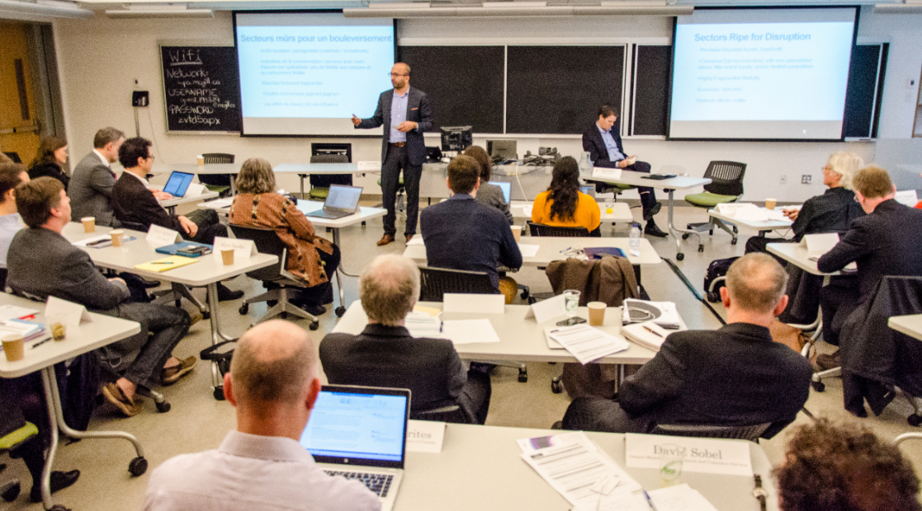
PARTNERSHIP FOR RESEARCH AND POLICY
Improving Research Targets and Reducing Lags
= one Partner overcoming a normal policy lag

Slide 11
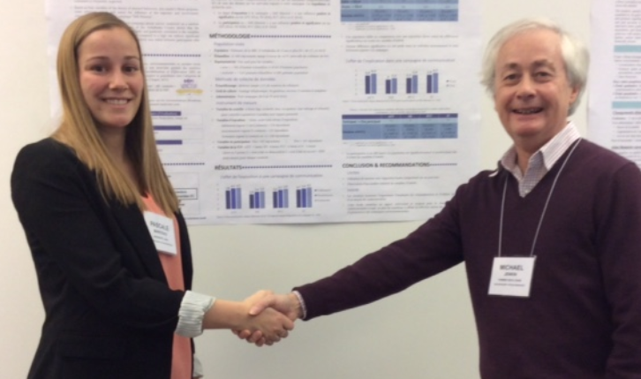
RICAPP /PPOCIR CAPACITY-BUILDING 2013 -2017
Graduate Student Research Projects Supported by SSHRC / CRSH and Partners and Presented at Workshops 2014-2017 http://ppocir.uwaterloo.ca/ppocir-knowledge-centre/ http://ppocir.uwaterloo.ca/fr/ppocir-knowledge-centre/
Consumer Empowerment Via Information Tech and AI
“Comparing the Public Policy Framework for Mobile Communication Devices in Canada, Australia, the United Kingdom and the United States: Convergence and Divergences,” Paul Goodrick, Ryerson University.
“Market Disruption or Market Equalization: Knowledge Engineering and Artificial Intelligence for Consumer Empowerment,” Selena Lucien, University of Ottawa / PIAC.
Modelling the Costs of Internet Delivery in Canada” Ben Klass, Carleton University.

Slide 12
Behavioural Tactics: Friend and Foe in Consumer Protection
“Assessing the Effects of Behavioural and Psychosocial Factors on Food Insecurity in Canada “. Gratias Gloria Denise Godonou, Université Laval.
“Bibliographical investigation of sociological contributions to PPOCIR in Canada,” Mathieu Lizotte, Université Laval
“The Construction and Regulation of Trust Mechanisms in the Sharing Economy,” Lukas Parker, Ryerson University.
« L’influence d’une campagne de sensibilisation au tri des déchets sur les comportements des consommateurs,» Pascale Marceau, Université Laval.
Food Disruptive Marketing and Consumer Empowerment
“Food Labeling for Children.” Shannon Allen, University of Alberta
“Intermittent Consumer of Organic Foods.” Camille Massey, Université Laval.
“Disruptive Technology in the Food Services Industry,” Shannon Allen, University of Alberta
“Food Fraud: Impact on Consumers and Mitigation Techniques,” Torie Murphy, Guelph University.

Slide 13
Ensuring the Consumer Interest Is Included in FinTech
Context-Setting: Canadian Consumer Finances,” Etienne Boucher, Laval University.
“Risky Business? Online peer to peer lending in Canada from the Consumer Perspective,” Ryan MacNeil, University of Ottawa; Partner: PIAC.
“Effectiveness of the implementation of Mobile Money Regulations: Developing Countries’ Lessons for Canada,” Ruba Itani, Ryerson University”.
« Les ainés : les finances personnelles et l’abus financier. » Patricia Long, Université Laval
Public Policy to Address New Deception and Scams – Online and Off
“Younger Consumers’ Attitude toward Counterfeit Goods,” Amy Faria,
University of Guelph.
“Every Day Legal Problems of Canadian Consumers: Findings of a 2014 General Population Survey,” Matthew McManus and David Kryszajtys York University.
“Cross-Jurisdictional Comparisons of Misleading Advertising, Privacy, Telecommunication and Copyright Consumer Protection Regimes: Preliminary Observations.” Lukas Parker, Ryerson University.
Old Tech, Old Law, New Tech, New Law?
“Meaningful Access to Justice and Consumer Problems in Canada,” Matthew McManus, York University.
“The Role of Social Media – Oriented Internet Platforms as Regulators of Online Conduct Through Terms-of-Service Provisions and the Regulation of Internet Services,” Madeleine Martin, Ryerson University. RRK15.12.2017

Slide 14
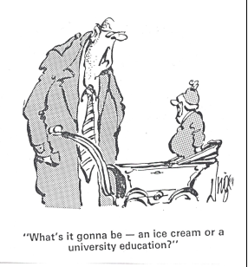

Rebalancing Disruption:
Behavioural Considerations
Jim Unger has Herman illustrate hyperbolic discounting or the present bias.
The Difficulty of any choice depends on size of the Challenge vs amount of consumer experience, K

Slide 15

CAN DIGITAL DISRUPTION HELP CONSUMERS BY REBALANCING POWER?
DISRUPTION OFTEN DECREASES C
DISRUPTION OFTEN INCREASES K
but…. there is an
URGENT NEED FOR REGULATION TO LIMIT
E-SCAMS AND OTHER FORMS OF MARKET
MISCONDUCT DESIGNED TO INCREASE C

Slide 16
The Next Partnership … Opportunity
Leader: Professor Ellen Goddard, University of Alberta
Ellen Goddard egoddard@ualberta.ca
FUTURE PARTNERSHIP: CONSUMER-INTEREST IN DISRUPTION
New advocacy strategies for consumer NGOs.
Innovative governance mechanisms for marketplace participants
Policy instruments and legislative tools for governments
New tools may well be essential - and hands-on regulation may often be replaced by a framework of behavioral incentives that increase rewards for positive innovations (or reduce the payoff from on-line harm - including innovation-by-deception).
Bob Kerton for Consumer Groups meeting

